Slide 1


Become part of Love Bristol Gift Card
How you can become a sales point for the Gift Card

Slide 2
P01
Why should I sell the Love Bristol Gift Card?
NO Costs. The BID covers the administration costs of these channels as part of their program.
Increased promotion & awareness for your business through collaboration with the program
Increase of footfall for new potential customers who come to purchase or pick up a card
Opportunity to support the local community through keeping spend within the local economy

Slide 3
P01
How does it help your business?
Sales Channels help increase sales and spend of the Gift Card in your city
Sales Channels increases Availability and Visibility in your city
Providing a sales channel is convenient for customers as it’s situated in the city and in person

Slide 4

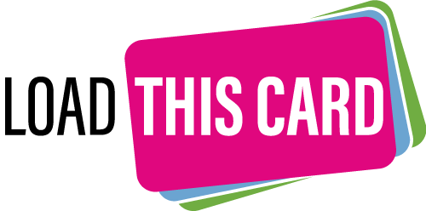

P01
What are the sales channels available?
Sales Points
Load This Card
Click & Collect

Slide 5
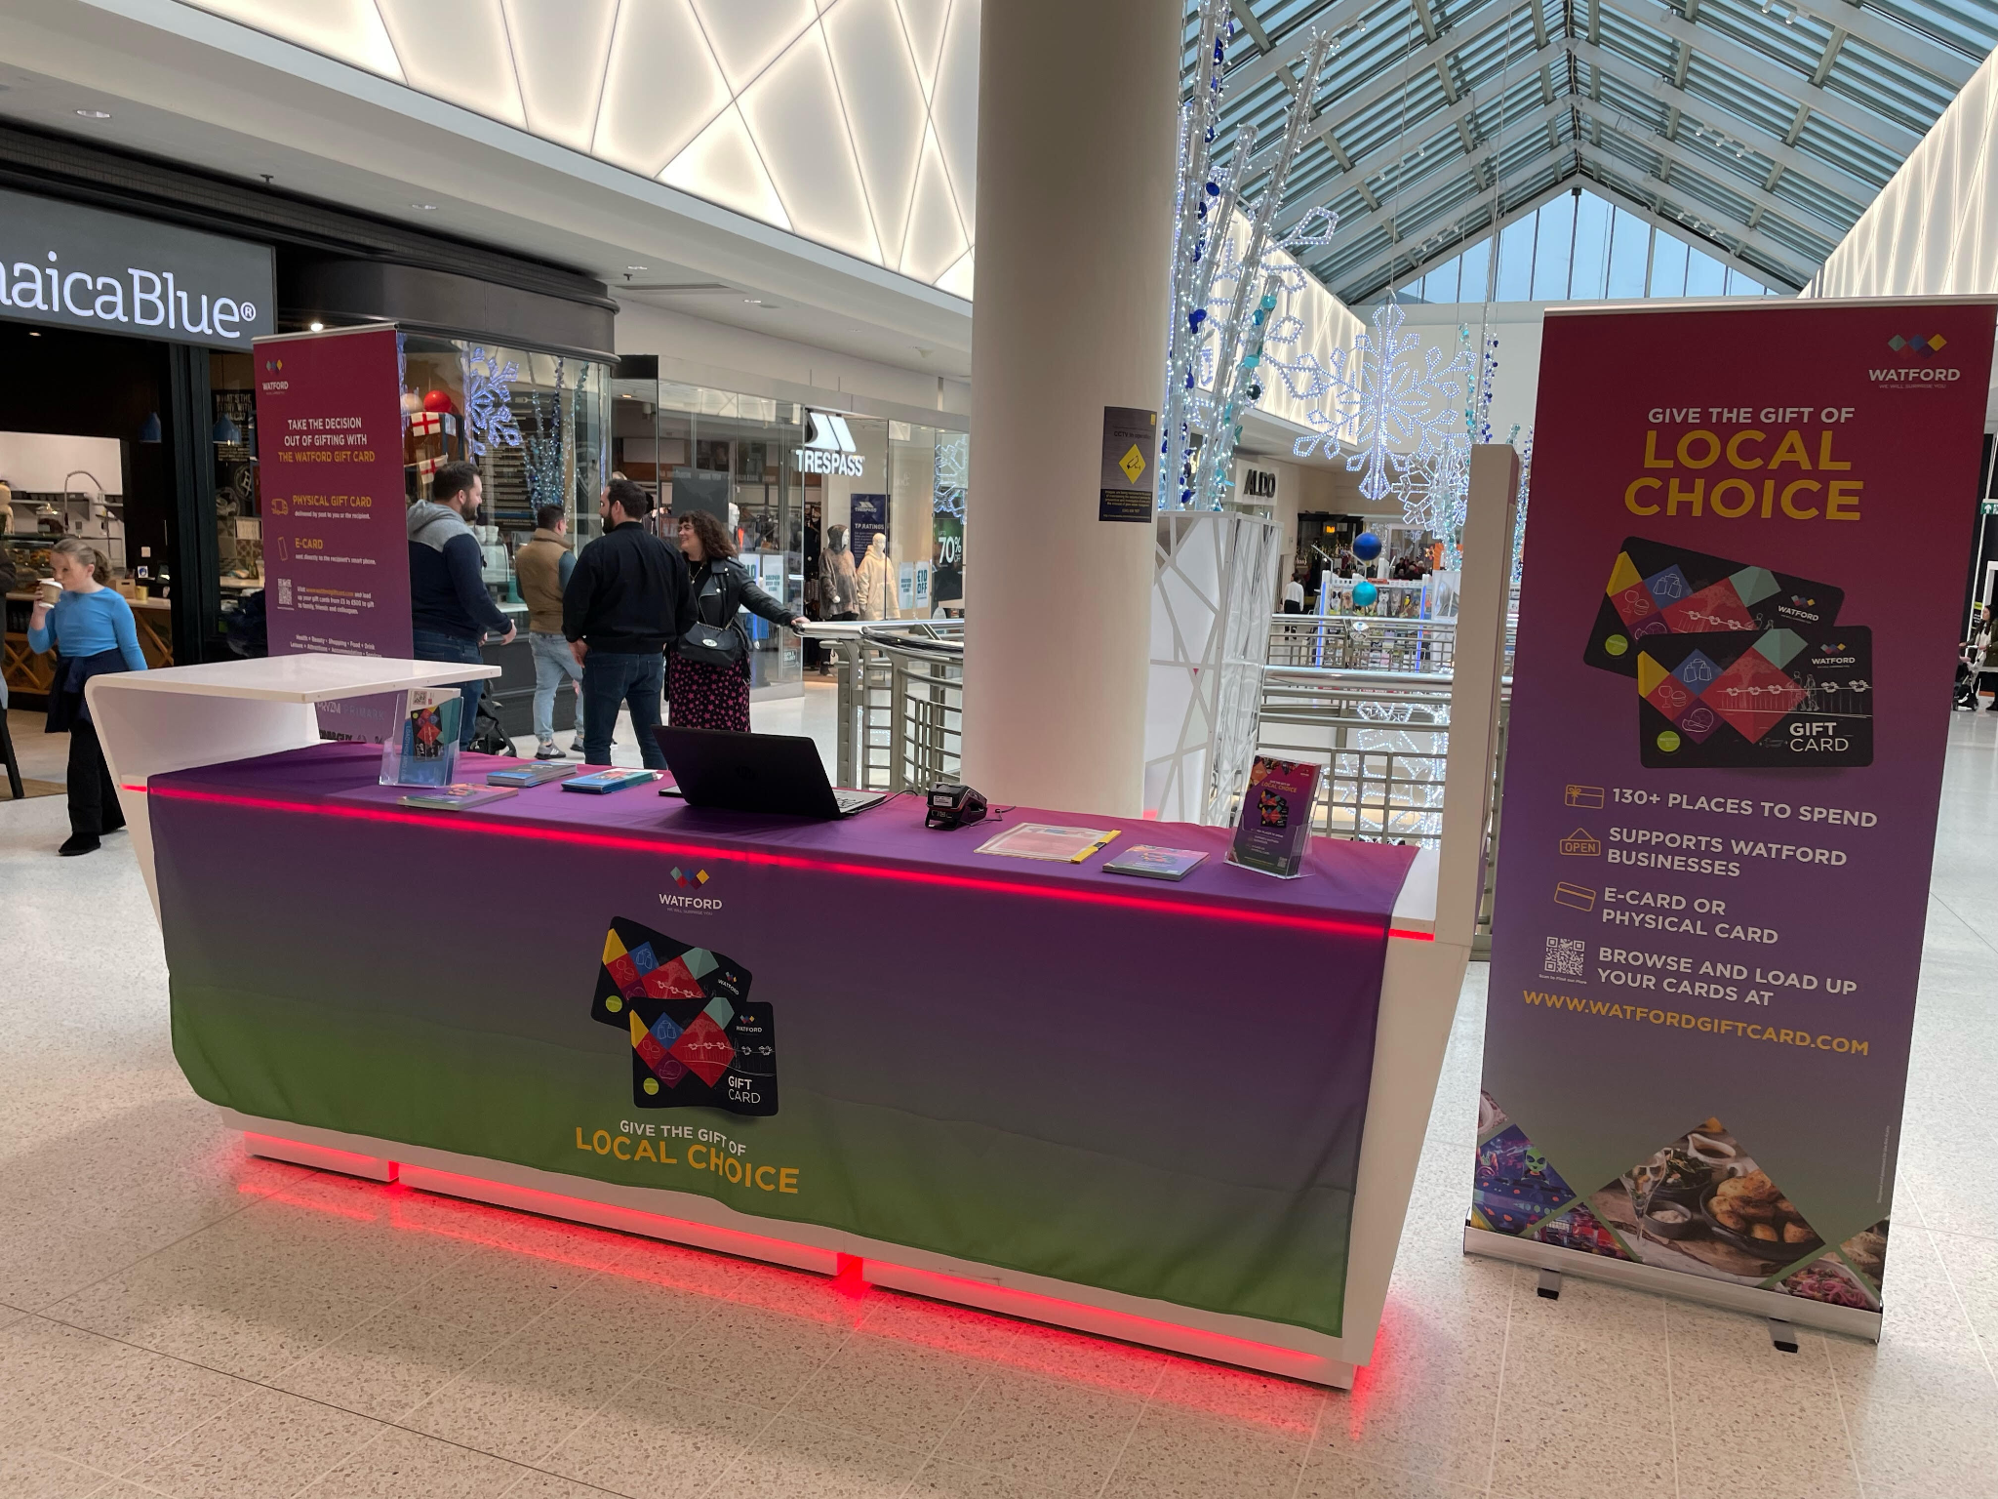
P01
Sales Point
Purchase in store

Slide 6
P01
Sales Point - Logistics
1
We do the initial set up
All initial conversations would be with the BID and Town & City Gift Cards. Once confirmed, all we require is for an agreement to be signed stating your approval to be a sales point.
Choose sales
method
Sales point can either:
(i) take payment with your own card machine and be invoiced or;
(ii) be supplied with a card machine only for Gift Card sales. There are NO costs of setting up, training and administering your sales points
Set-up is
simple
Miconex take care of the admin.
We provide training for your teams, and the BID are on hand to visit in person if you require assistance at any stage.
Promotion
We would market your business on the Love Bristol Gift Card webpage, and promote on socials to purchase cards in store.
.
1
1

Slide 7
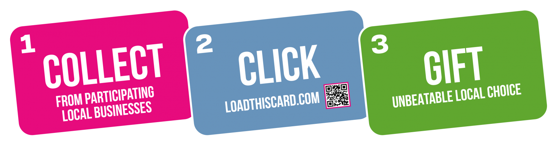
P01
Load This Card
Collect in store, load at home

Slide 8
P01
Load This Card - Logistics
1
We do the initial set up
All initial conversations would be with the BID and Town & City Gift Cards. Once confirmed, all we require is for an agreement to be signed stating your approval to provide Load This Cards to customers.
Simple channel for customer service
The benefit for Load This Card is that there is less service that the team in your store would need to provide. The customer simply picks up a Gift Card that they load at home via www.loadthiscard.com
Promotion
We would market your business on the Love Bristol Gift Card webpage, and promote on socials to purchase cards in store.
.
1
1

Slide 9

P01
Click & Collect
Purchase online, collect in store

Slide 10
P01
Click & Collect - Logistics
1
We do the initial set up
All initial conversations would be with the BID and Town & City Gift Cards. Once confirmed, all we require is for an agreement to be signed stating your approval to be a sales point.
Set-up is
simple
Orders are purchased online via our website. All your team would need to do is load the cards and hand them to the customers at an agreed collection date.
We will provide training to your team, plus all user guides and troubleshooting. At any time we also have a support team to assist you with help.
Promotion
We would market your business on the Love Bristol Gift Card webpage, and promote on socials to purchase cards in store.
.
1
1

Slide 11
P01
Next steps..
Contact us to set up your preferred sales channel.
Anna Taylor
Client Growth Manager
Miconex Group
anna@mi-cnx.com

